Slide 1

3D Object Detection

Slide 2
Contents
Intro of Object Detection
Point Clouds
CNN
PointNet
ConvNet

Slide 3
Intro
Object detection supports a wide range of applications, including robot vision, consumer electronics, security, autonomous driving, human computer interaction, content based image retrieval, intelligent video surveillance and augmented reality.
object detection can be grouped into one of two types (Grauman and Leibe 2011; Zhang et al.2013): detection of specific instances versus the detection of broad categories.
The first type aims to detect instances of a particular object (such as Donald Trump’s face, the Eiffel Tower, or a neighbor’s dog), essentially a matching problem.

Slide 4
Generic object detection, also called generic object category detection, object class detection, or object category detection (Zhang et al. 2013), is defined as follows. Given an image, determine whether or not there are instances of objects from predefined categories (usually many categories, e.g., 200 categories in the ILSVRC object detection challenge) and, if present, to return the spatial location and extent of each instance. A greater emphasis is placed on detecting a broad range of natural categories, as opposed to specific object category detection where only a narrower predefined category of interest (e.g., faces, pedestrians, or cars) may be present.
The ideal of generic object detection is to develop a general purpose algorithm that achieves two competing goals of high quality/accuracy and high efficiency

Slide 5
Accuracy Related Challenges
Challenges in detection accuracy stem from (1) the vast range of intra-class variations and (2) the huge number of object categories.
Intra-class variations can be divided into two types: intrinsic factors and imaging conditions. In terms of intrinsic factors, each object category can have many different object instances, possibly varying in one or more of color, texture, material, shape, and size, such as the “chair” category

Slide 6
Convolutional Neural Networks (CNNs)
CNNs the most representative models of deep learning, are able to exploit the basic properties underlying natural signals: translation invariance, local connectivity, and compositional hierarchies (LeCunet al. 2015).
In general, the initial CNN layers extract low-level features (e.g., edges), with later layers extracting more general features of increasing complexity
DCNNs have a number of outstanding advantages: a hierarchical structure to learn representations of data with multiple levels of abstraction, the capacity to learn very complex functions, and learning feature representations directly and automatically from data with minimal domain knowledge.

Slide 7
Evaluation Criteria
There are three criteria for evaluating the performance of detection algorithms: detection speed in Frames Per Second (FPS), precision, and recall. The most commonly used metric is Average Precision (AP), derived from precision and recall.
AP is usually evaluated in a category specific manner, i.e., computed for each object category separately. To compare performance over all object categories, the mean AP (mAP) averaged over all object categories is adopted as the final measure of performance3.
we design a novel type of neural network that directly consumes point clouds, which well respects the permutation invariance of points in the input. Our network, named PointNet, provides a unified architecture for applications ranging from object classification, part segmentation, to scene semantic parsing. Though simple, PointNet is highly efficient and effective. Empirically, it shows strong performance on par or even better than state of the art.

Slide 8
DataSets
The COCO object detection challenge (Linet al. 2014) features two object detection tasks: using either bounding box output or object instance segmentation output.
COCO introduced three new challenges:
1. It contains objects at a wide range of scales, including a high percentage of small objects (Singh and Davis 2018);
2. Objects are less iconic and amid clutter or heavy occlusion;
3. The evaluation metric (see Table 5) encourages more accurate object localization.

Slide 9
Frustum PointNets for 3D Object Detection from RGB-D Data
3D object detection from RGBD data in both indoor and outdoor scenes. While previous methods focus on images or 3D voxels, often obscuring natural 3D patterns and invariances of 3D data, we directly operate on raw point clouds by popping up RGB-D scans.
However, a key challenge of this approach is how to efficiently localize objects in point clouds of large-scale scenes (region proposal). Instead of solely relying on 3D proposals, our method leverages both mature 2D object detectors and advanced 3D deep learning for object localization, achieving efficiency as well as high recall for even small objects.
We use connected component with segmentation scores to get object proposals in scenes. Starting from a random point in the scene, we find its predicted label and use BFS to search nearby points with the same label, with a search radius of 0:2 meter. If the resulted cluster has more than 200 points (assuming a 4096 point sample in a 1m by 1m area), the cluster’s bounding box is marked as one object proposal. For each proposed object, it’s detection score is computed as the average point score for that category. Before evaluation, proposals with extremely small areas/volumes are pruned.

Slide 10
Model Retrieval from Point Cloud Our PointNet learns a global shape signature for every given input point cloud. We expect geometrically similar shapes have similar global signature. In this section, we test our conjecture on the shape retrieval application. To be more specific, for every given query shape from ModelNet test split, we compute its global signature (output of the layer before the score prediction layer) given by our classification PointNet and retrieve similar shapes in the train split by nearest neighbor search.
Scene Semantic Parsing Visualization We give a visualization of semantic parsing in Fig 24 where we show input point cloud, prediction and ground truth for both semantic segmentation and object detection for two office rooms and one conference room. The area and the rooms are unseen in the training set.
Point Function Visualization Our classification Point-Net computes K (K = 1024 in this visualization) dimension point features for each point and aggregates all the per-point local features via a max pooling layer into a single K-dim vector, which forms the global shape descriptor. To gain more insights on what the learnt per-point functions h’s detect, we visualize the points pi’s that give high per-point function value f(pi) in Fig 19. This visualization clearly shows that different point functions learn to detect for points in different regions.

Slide 11
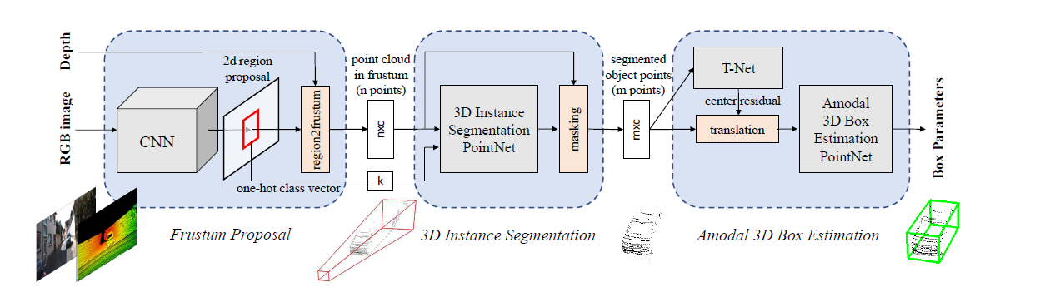
Frustrum PointNet Architecture

Slide 12
Frustum ConvNet: Sliding Frustums to Aggregate Local Point-Wise Features for Amodal 3D Object Detection
Given 2D region proposals in an RGB image, our method first generates a sequence of frustums for each region proposal, and uses the obtained frustums to group localpoints.
F-ConvNet aggregates point-wise features as frustum level feature vectors, and arrays these feature vectors as a feature map for use of its subsequent component of fully convolutional network (FCN), which spatially fuses frustum-level features and supports an end-to-end and continuous estimation of oriented boxes in the 3D space.

Slide 13
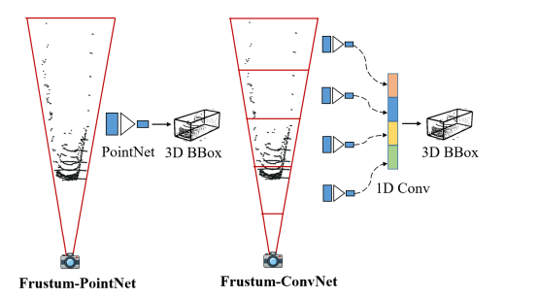

Slide 14
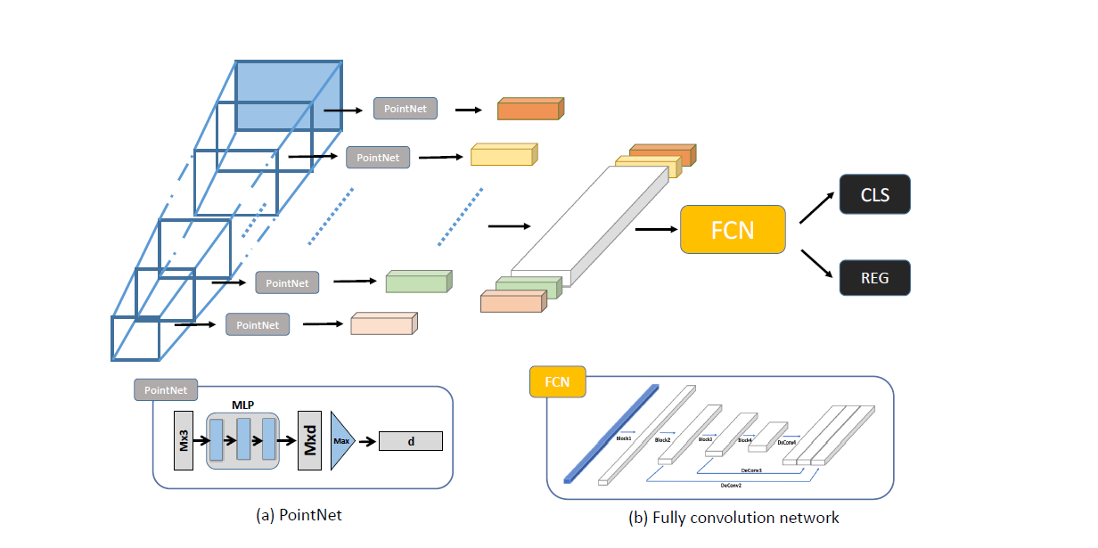
Frustrum ConvNet Architecture

Slide 15
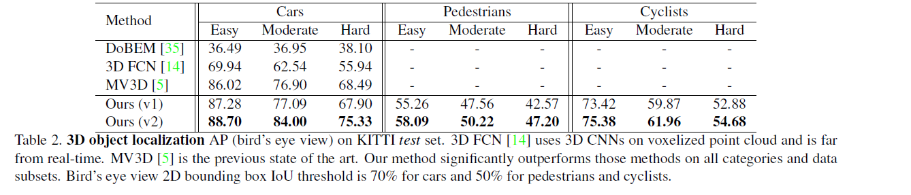
Comparison
Data Source Reference:
Frustum PointNets for 3D Object Detection From RGB-D Data (thecvf.com)

Slide 16
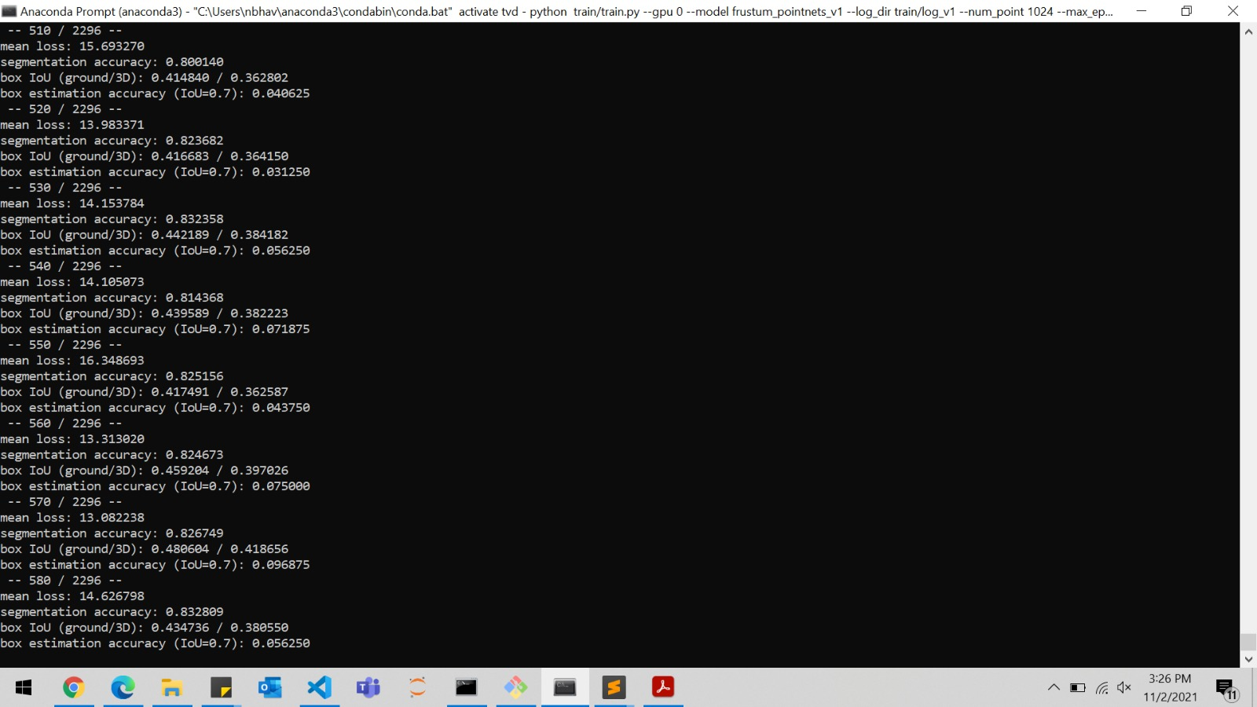
Training and Testing of Frustrum PointNet

Slide 17
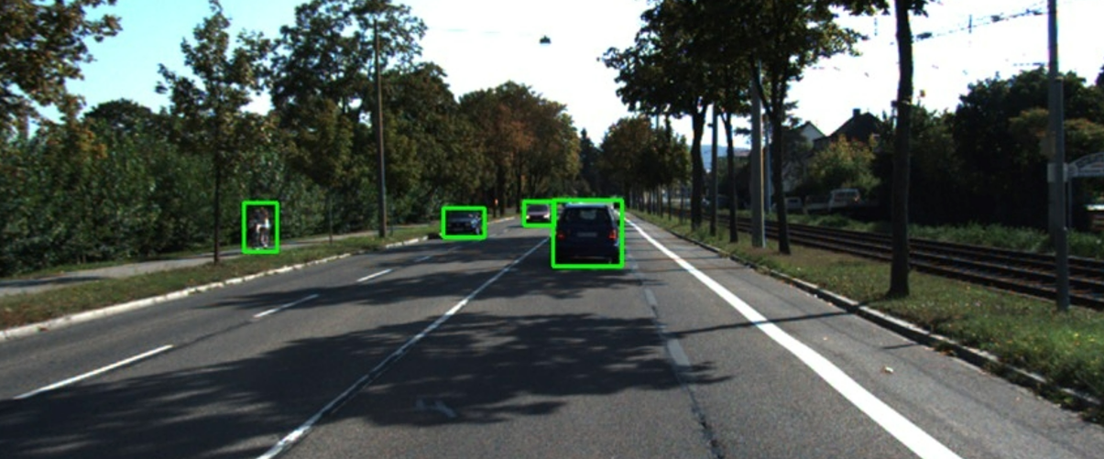
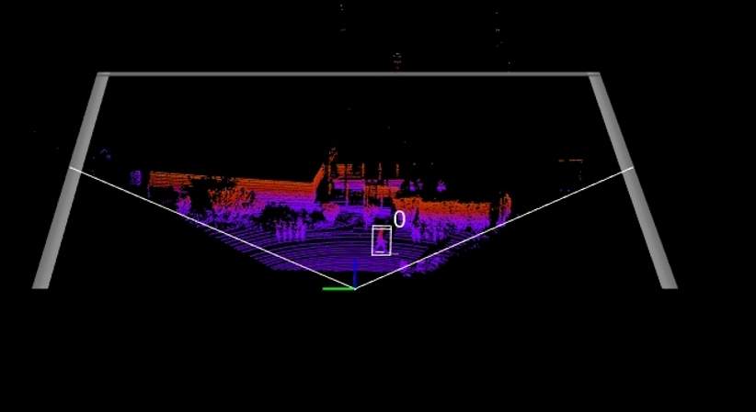
Images while Testing Frustrum PointNet

Slide 18
References
Frustum PointNets for 3D Object Detection From RGB-D Data (thecvf.com)
1903.01864.pdf (arxiv.org)
Image type detection - Computer Vision - Azure Cognitive Services | Microsoft Docs
PointNet (stanford.edu)
The KITTI Vision Benchmark Suite (cvlibs.net)

Slide 19
Thanks for Joining

